Slide 1
Machine-Level Programming IV: Data

Slide 2
Today
Arrays
  One-dimensional
  Multi-dimensional (nested)
  Multi-level
Structures
  Allocation
  Access
  Alignment

Slide 3
Array Allocation
Basic Principle
  T A[L];
  Array of data type T and length L
  Contiguously allocated region of L * sizeof(T) bytes in memory
char string[12];
x
x + 12
int val[5];
x
x + 4
x + 8
x + 12
x + 16
x + 20
double a[3];
x
x + 8
x + 16
x + 24
char *p[3];
x
x + 8
x + 16
x + 24

Slide 4
Array Access
Basic Principle
  T A[L];
  Array of data type T and length L
  Identifier A can be used as a pointer to array element 0: Type T*
Reference Type Value
  val[4] int 3
  val int * x
  val+1 int * x + 4
  &val[2] int * x + 8
  val[5] int ??
  *(val+1) int 5
  val + i int * x + 4 i
int val[5];
1
5
2
1
3
x
x + 4
x + 8
x + 12
x + 16
x + 20

Slide 5
Array Example
#define ZLEN 5
typedef int zip_dig[ZLEN];
zip_dig c = { 1, 5, 2, 1, 3 };
zip_dig m = { 0, 2, 1, 3, 9 };
zip_dig u = { 9, 4, 7, 2, 0 };
zip_dig c;
1
5
2
1
3
16
20
24
28
32
36
zip_dig m;
0
2
1
3
9
36
40
44
48
52
56
zip_dig u;
9
4
7
2
0
56
60
64
68
72
76
Declaration “zip_dig c” equivalent to “int c[5]”
Example arrays were allocated in successive 20 byte blocks
  Not guaranteed to happen in general

Slide 6
Array Accessing Example
zip_dig c;
1
5
2
1
3
16
20
24
28
32
36
int get_digit
(zip_dig z, int digit)
{
return z[digit];
}
Register %rdi contains starting address of array
Register %rsi contains
array index
Desired digit at
%rdi + 4*%rsi
Use memory reference (%rdi,%rsi,4)
IA32
# %rdi = z
# %rsi = digit
movl (%rdi,%rsi,4), %eax # z[digit]

Slide 7
Array Loop Example
void zincr(zip_dig z) {
size_t i;
for (i = 0; i < ZLEN; i++)
z[i]++;
}
# %rdi = z
movl $0, %eax # i = 0
jmp .L3 # goto middle
.L4: # loop:
addl $1, (%rdi,%rax,4) # z[i]++
addq $1, %rax # i++
.L3: # middle
cmpq $4, %rax # i:4
jbe .L4 # if <=, goto loop
rep; ret

Slide 8
Multidimensional (Nested) Arrays
Declaration
  T A[R][C];
  2D array of data type T
  R rows, C columns
  Type T element requires K bytes
Array Size
  R * C * K bytes
Arrangement
  Row-Major Ordering
A[0][0]
• • •
A[0][C-1]
•
•
•
•
•
•
A[R-1][0]
• • •
A[R-1][C-1]
int A[R][C];
• • •
A
[0]
[0]
A
[0]
[C-1]
• • •
A
[1]
[0]
A
[1]
[C-1]
• • •
• • •
A
[R-1]
[0]
A
[R-1]
[C-1]
4*R*C Bytes
Notes:
Board: show 3D example: a[2][3][2] to illustrate the idea of row major as enumerating indices from right to left

Slide 9
Nested Array Example
#define PCOUNT 4
zip_dig p[PCOUNT] =
{{1, 5, 2, 0, 6},
{1, 5, 2, 1, 3 },
{1, 5, 2, 1, 7 },
{1, 5, 2, 2, 1 }};
zip_dig p[4];
1
5
2
0
6
1
5
2
1
3
1
5
2
1
7
1
5
2
2
1
76
96
116
136
156
“zip_dig p[4]” equivalent to “int p[4][5]”
  Variable p: array of 4 elements, allocated contiguously
  Each element is an array of 5 int’s, allocated contiguously
“Row-Major” ordering of all elements in memory

Slide 10
Nested Array Row Access
Row Vectors
  A[i] is array of C elements
  Each element of type T requires K bytes
  Starting address A + i * (C * K)
int A[R][C];
A[0]
A[i]
A[R-1]
• • •
A
[0]
[0]
A
[0]
[C-1]
• • •
• • •
A
[i]
[0]
A
[i]
[C-1]
• • •
• • •
A
[R-1]
[0]
A
[R-1]
[C-1]
A
A+(i*C*4)
A+((R-1)*C*4)

Slide 11
Nested Array Row Access Code
1
5
2
0
6
1
5
2
1
3
1
5
2
1
7
1
5
2
2
1
pgh
int *get_pgh_zip(int index)
{
return p[index];
}
# %rdi = index
leaq (%rdi,%rdi,4),%rax # 5 * index
leaq p(,%rax,4),%rax # p + (20 * index)
Row Vector
  p[index] is array of 5 int’s
  Starting address p+20*index
Machine Code
  Computes and returns address
  Compute as p + 4*(index+4*index)

Slide 12
Nested Array Element Access
Array Elements
  A[i][j] is element of type T, which requires K bytes
  Address A + i * (C * K) + j * K = A + (i * C + j)* K
int A[R][C];
A[0]
A[i]
A[R-1]
• • •
A
[0]
[0]
A
[0]
[C-1]
• • •
• • • • • •
A
[i]
[j]
• • •
• • •
A
[R-1]
[0]
A
[R-1]
[C-1]
A
A+(i*C*4)
A+((R-1)*C*4)
A+(i*C*4)+(j*4)

Slide 13
Nested Array Element Access Code
1
5
2
0
6
1
5
2
1
3
1
5
2
1
7
1
5
2
2
1
p
int get_pgh_digit (int index, int dig)
{
return p[index][dig];
}
leaq (%rdi,%rdi,4), %rax # 5*index
addl %rax, %rsi # 5*index+dig
movl p(,%rsi,4), %eax # M[p + 4*(5*index+dig)]
Array Elements
  p[index][dig] is int
  Address: p + 20*index + 4*dig
    = p + 4*(5*index + dig)

Slide 14
Multi-Level Array Example
zip_dig c = { 1, 5, 2, 1, 3 };
zip_dig m = { 0, 2, 1, 3, 9 };
zip_dig u = { 9, 4, 7, 2, 0 };
Variable b denotes array of 3 elements
Each element is a pointer
  8 bytes
Each pointer points to array of int’s
#define UCOUNT 3
int *b[UCOUNT] = {m, c, u};
c
1
5
2
1
3
b
16
20
24
28
32
36
160
36
m
0
2
1
3
9
168
16
36
40
44
48
52
56
176
56
u
9
4
7
2
0
56
60
64
68
72
76

Slide 15
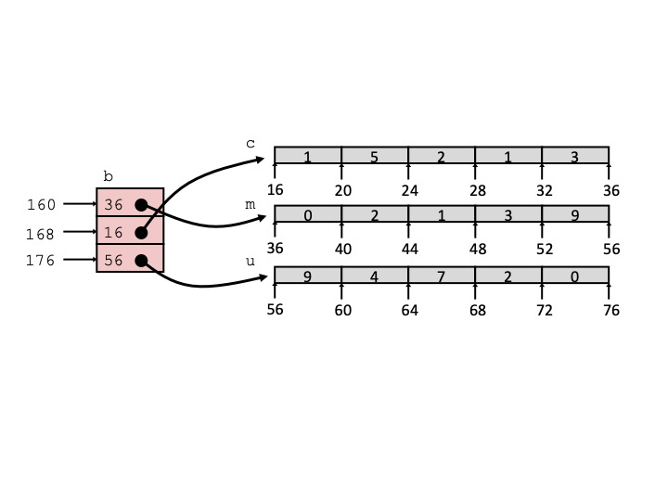
Element Access in Multi-Level Array
int get_b_digit
(size_t index, size_t digit)
{
return b[index][digit];
}
salq $2, %rsi # 4*digit
addq b(,%rdi,8), %rsi # p = b[index] + 4*digit
movl (%rsi), %eax # return *p
ret
Computation
  Element access Mem[Mem[b+8*index]+4*digit]
  Must do two memory reads
    First get pointer to row array
    Then access element within array

Slide 16
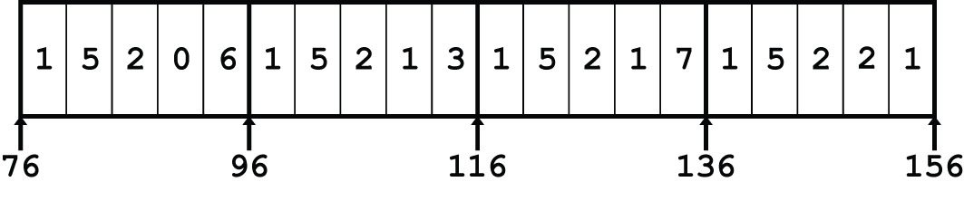
Array Element Accesses
Nested array
Multi-level array
int get_pgh_digit
(size_t index, size_t digit)
{
return p[index][digit];
}
int get_b_digit
(size_t index, size_t digit)
{
return b[index][digit];
}
Accesses looks similar in C, but address computations very different:
Mem[pgh+20*index+4*digit]
Mem[Mem[univ+8*index]+4*digit]

Slide 17
N X N Matrix Code
#define N 16
typedef int fix_matrix[N][N];
/* Get element a[i][j] */
int fix_ele(fix_matrix a,
size_t i, size_t j)
{
return a[i][j];
}
Fixed dimensions
  Know value of N at compile time
Variable dimensions, explicit indexing
  Traditional way to implement dynamic arrays
Variable dimensions, implicit indexing
  Now supported by gcc
#define IDX(n, i, j) ((i)*(n)+(j))
/* Get element a[i][j] */
int vec_ele(size_t n, int *a,
size_t i, size_t j)
{
return a[IDX(n,i,j)];
}
/* Get element a[i][j] */
int var_ele(size_t n, int a[n][n],
size_t i, size_t j) {
return a[i][j];
}

Slide 18
16 X 16 Matrix Access
Array Elements
  Address A + i * (C * K) + j * K
  C = 16, K = 4
/* Get element a[i][j] */
int fix_ele(fix_matrix a, size_t i, size_t j) {
return a[i][j];
}
# a in %rdi, i in %rsi, j in %rdx
salq $6, %rsi # 64*i
addq %rsi, %rdi # a + 64*i
movl (%rdi,%rdx,4), %eax # M[a + 64*i + 4*j]
ret

Slide 19
n X n Matrix Access
Array Elements
  Address A + i * (C * K) + j * K
  C = n, K = 4
  Must perform integer multiplication
/* Get element a[i][j] */
int var_ele(size_t n, int a[n][n], size_t i, size_t j) {
return a[i][j];
}
# n in %rdi, a in %rsi, i in %rdx, j in %rcx
imulq %rdx, %rdi # n*i
leaq (%rsi,%rdi,4), %rax # a + 4*n*i
movl (%rax,%rcx,4), %eax # a + 4*n*i + 4*j
ret

Slide 20
Today
Arrays
  One-dimensional
  Multi-dimensional (nested)
  Multi-level
Structures
  Allocation
  Access
  Alignment

Slide 21
Structure Representation
r
struct rec {
int a[4];
size_t i;
struct rec *next;
};
a
i
next
0
16
24
32
Structure represented as block of memory
  Big enough to hold all of the fields
Fields ordered according to declaration
  Even if another ordering could yield a more compact representation
Compiler determines overall size + positions of fields
  Machine-level program has no understanding of the structures in the source code

Slide 22
Generating Pointer to Structure Member
r
r+4*idx
struct rec {
int a[4];
size_t i;
struct rec *next;
};
a
i
next
0
16
24
32
Generating Pointer to Array Element
  Offset of each structure member determined at compile time
  Compute as r + 4*idx
int *get_ap
(struct rec *r, size_t idx)
{
return &r->a[idx];
}
# r in %rdi, idx in %rsi
leaq (%rdi,%rsi,4), %rax
ret

Slide 23
Following Linked List
struct rec {
int a[4];
int i;
struct rec *next;
};
C Code
r
void set_val
(struct rec *r, int val)
{
while (r) {
int i = r->i;
r->a[i] = val;
r = r->next;
}
}
a
i
next
0
16
24
32
Element i
Register | Value
%rdi | r
%rsi | val
.L11: # loop:
movslq 16(%rdi), %rax # i = M[r+16]
movl %esi, (%rdi,%rax,4) # M[r+4*i] = val
movq 24(%rdi), %rdi # r = M[r+24]
testq %rdi, %rdi # Test r
jne .L11 # if !=0 goto loop

Slide 24
Structures & Alignment
Unaligned Data
Aligned Data
  Primitive data type requires K bytes
  Address must be multiple of K
struct S1 {
char c;
int i[2];
double v;
} *p;
c
i[0]
i[1]
v
p
p+1
p+5
p+9
p+17
c
3 bytes
i[0]
i[1]
4 bytes
v
p+0
p+4
p+8
p+16
p+24
Multiple of 4
Multiple of 8
Multiple of 8
Multiple of 8

Slide 25
Alignment Principles
Aligned Data
  Primitive data type requires K bytes
  Address must be multiple of K
  Required on some machines; advised on x86-64
Motivation for Aligning Data
  Memory accessed by (aligned) chunks of 4 or 8 bytes (system dependent)
    Inefficient to load or store datum that spans quad word boundaries
    Virtual memory trickier when datum spans 2 pages
Compiler
  Inserts gaps in structure to ensure correct alignment of fields

Slide 26
Specific Cases of Alignment (x86-64)
1 byte: char, …
  no restrictions on address
2 bytes: short, …
  lowest 1 bit of address must be 02
4 bytes: int, float, …
  lowest 2 bits of address must be 002
8 bytes: double, long, char *, …
  lowest 3 bits of address must be 0002
16 bytes: long double (GCC on Linux)
  lowest 4 bits of address must be 00002

Slide 27
Satisfying Alignment with Structures
Within structure:
  Must satisfy each element’s alignment requirement
Overall structure placement
  Each structure has alignment requirement K
    K = Largest alignment of any element
  Initial address & structure length must be multiples of K
Example:
  K = 8, due to double element
struct S1 {
char c;
int i[2];
double v;
} *p;
c
3 bytes
i[0]
i[1]
4 bytes
v
p+0
p+4
p+8
p+16
p+24
Multiple of 4
Multiple of 8
Multiple of 8
Multiple of 8

Slide 28
Meeting Overall Alignment Requirement
For largest alignment requirement K
Overall structure must be multiple of K
struct S2 {
double v;
int i[2];
char c;
} *p;
 | v |  |  |  |  |  |  | i[0] |  |  |  | i[1] |  |  |  | c | 7 bytes
p+0 |  |  |  |  |  |  | p+8 |  |  |  |  |  |  |  | p+16 |  |  |  |  |  |  |  | p+24
Multiple of K=8

Slide 29
Arrays of Structures
struct S2 {
double v;
int i[2];
char c;
} a[10];
Overall structure length multiple of K
Satisfy alignment requirement
for every element
 | a[0] |  |  |  |  | a[1] |  |  |  |  | a[2] |  |  |  |  | • • •
a+0 |  |  |  |  | a+24 |  |  |  |  | a+48 |  |  |  |  | a+72
 | v |  |  |  |  |  |  | i[0] |  |  |  | i[1] |  |  |  | c | 7 bytes
a+24 |  |  |  |  |  |  | a+32 |  |  |  |  |  |  |  | a+40 |  |  |  |  |  |  |  | a+48

Slide 30
Accessing Array Elements
struct S3 {
short i;
float v;
short j;
} a[10];
Compute array offset 12*idx
  sizeof(S3), including alignment spacers
Element j is at offset 8 within structure
Assembler gives offset a+8
  Resolved during linking
 | a[0] |  |  |  |  | • • • |  |  |  | a[idx] |  |  |  | • • |  |  | •
a+0 |  |  |  |  | a+12 |  |  |  | a+12*idx
 |  |  |  |  | i | 2 bytes |  | v |  |  | j | 2 bytes
 |  |  |  | a+12*idx |  |  |  |  |  | a+12*idx+8
short get_j(int idx)
{
return a[idx].j;
}
# %rdi = idx
leaq (%rdi,%rdi,2),%rax # 3*idx
movzwl a+8(,%rax,4),%eax

Slide 31
Saving Space
Put large data types first
Effect (K=4)
struct S4 {
char c;
int i;
char d;
} *p;
struct S5 {
int i;
char c;
char d;
} *p;
c
3 bytes
i
d
3 bytes
i
c
d
2 bytes

