Slide 1
SE 536 Lecture 10
Ljubomir Perkovic

Slide 2
Outline
Project discussion
Wireless systems
Multiplayer online games

Slide 3
Mobile Ad Hoc Networks
Formed by wireless hosts which may be mobile
Without (necessarily) using a pre-existing infrastructure
Routes between nodes may potentially contain multiple hops

Slide 4
Mobile Ad Hoc Networks
A
B
May need to traverse multiple links to reach a destination

Slide 5
Mobile Ad Hoc Networks (MANET)
A
B
Mobility causes route changes

Slide 6
Why Ad Hoc Networks ?
Ease of deployment
Speed of deployment
Decreased dependence on infrastructure

Slide 7
Many Applications
Personal area networking
cell phone, laptop, ear phone, wrist watch
Military environments
soldiers, tanks, planes
Civilian environments
Mesh networks
taxi cab network
meeting rooms
sports stadiums
boats, small aircraft
Emergency operations
search-and-rescue
policing and fire fighting

Slide 8
Many Variations
Fully Symmetric Environment
all nodes have identical capabilities and responsibilities
Asymmetric Capabilities
transmission ranges and radios may differ
battery life at different nodes may differ
processing capacity may be different at different nodes
speed of movement
Asymmetric Responsibilities
only some nodes may route packets
some nodes may act as leaders of nearby nodes (e.g., cluster head)

Slide 9
Many Variations
Traffic characteristics may differ in different ad hoc networks
bit rate
timeliness constraints
reliability requirements
unicast / multicast / geocast
host-based addressing / content-based addressing / capability-based addressing
May co-exist (and co-operate) with an infrastructure-based network

Slide 10
Many Variations
Mobility patterns may be different
people sitting at an airport lounge
New York taxi cabs
kids playing
military movements
personal area network
Mobility characteristics
speed
predictability
direction of movement
pattern of movement
uniformity (or lack thereof) of mobility characteristics among different nodes

Slide 11
Challenges
Limited wireless transmission range
Broadcast nature of the wireless medium
Hidden terminal problem (see next slide)
Packet losses due to transmission errors
Mobility-induced route changes
Mobility-induced packet losses
Battery constraints
Potentially frequent network partitions
Ease of snooping on wireless transmissions (security hazard)

Slide 12
Hidden Terminal Problem
A
B
C
Nodes A and C cannot hear each other
Transmissions by nodes A and C can collide at node B
Nodes A and C are hidden from each other

Slide 13
Why is Routing in MANET different ?
Host mobility
link failure/repair due to mobility may have different characteristics than those due to other causes
Rate of link failure/repair may be high when nodes move fast
New performance criteria may be used
route stability despite mobility
energy consumption

Slide 14
Unicast Routing Protocols
Many protocols have been proposed
Some have been invented specifically for MANET
Others are adapted from previously proposed protocols for wired networks
No single protocol works well in all environments
some attempts made to develop adaptive protocols

Slide 15
Flooding for Data Delivery
Y
Z
S
E
F
B
C
M
L
J
A
G
H
D
K
I
N
Represents a node that has received packet P
Represents that connected nodes are within each
other’s transmission range

Slide 16
Flooding for Data Delivery
Y
Broadcast transmission
Z
S
E
F
B
C
M
L
J
A
G
H
D
K
I
N
Represents a node that receives packet P for
the first time
Represents transmission of packet P

Slide 17
Flooding for Data Delivery
Y
Z
S
E
F
B
C
M
L
J
A
G
H
D
K
I
N
Node H receives packet P from two neighbors:
potential for collision

Slide 18
Flooding for Data Delivery
Y
Z
S
E
F
B
C
M
L
J
A
G
H
D
K
I
N
Node C receives packet P from G and H, but does not forward
it again, because node C has already forwarded packet P once

Slide 19
Flooding for Data Delivery
Y
Z
S
E
F
B
C
M
L
J
A
G
H
D
K
I
N
Nodes J and K both broadcast packet P to node D
Since nodes J and K are hidden from each other, their
transmissions may collide
=> Packet P may not be delivered to node D at all,
despite the use of flooding

Slide 20
Flooding for Data Delivery
Y
Z
S
E
F
B
C
M
L
J
A
G
H
D
K
I
N
Node D does not forward packet P, because node D
is the intended destination of packet P

Slide 21
Flooding for Data Delivery
Y
Z
S
E
F
B
C
M
L
J
A
G
H
D
K
I
N
Flooding completed
Nodes unreachable from S do not receive packet P (e.g., node Z)
Nodes for which all paths from S go through the destination D
also do not receive packet P (example: node N)

Slide 22
Flooding for Data Delivery
Y
Z
S
E
F
B
C
M
L
J
A
G
H
D
K
I
N
Flooding may deliver packets to too many nodes
(in the worst case, all nodes reachable from sender
may receive the packet)

Slide 23
Flooding for Data Delivery: Advantages
Simplicity
May be more efficient than other protocols when rate of information transmission is low enough that the overhead of explicit route discovery/maintenance incurred by other protocols is relatively higher
this scenario may occur, for instance, when nodes transmit small data packets relatively infrequently, and many topology changes occur between consecutive packet transmissions
Potentially higher reliability of data delivery
Because packets may be delivered to the destination n multiple paths

Slide 24
Flooding for Data Delivery: Disadvantages
Potentially, very high overhead
Data packets may be delivered to too many nodes who do not need to receive them
Potentially lower reliability of data delivery
Flooding uses broadcasting -- hard to implement reliable broadcast delivery without significantly increasing overhead
Broadcasting in IEEE 802.11 MAC is unreliable
In our example, nodes J and K may transmit to node D simultaneously, resulting in loss of the packet
in this case, destination would not receive the packet at all

Slide 25
Flooding of Control Packets
Many protocols perform (potentially limited) flooding of control packets, instead of data packets
The control packets are used to discover routes
Discovered routes are subsequently used to send data packet(s)
Overhead of control packet flooding is amortized over data packets transmitted between consecutive control packet floods

Slide 26
Dynamic Source Routing (DSR)
When node S wants to send a packet to node D, but does not know a route to D, node S initiates a route discovery
Source node S floods Route Request (RREQ)
Each node appends own identifier when forwarding RREQ

Slide 27
Route Discovery in DSR
Y
Z
S
E
F
B
C
M
L
J
A
G
H
D
K
I
N
Represents a node that has received RREQ for D from S

Slide 28
Route Discovery in DSR
Y
Broadcast transmission
[S]
Z
S
E
F
B
C
M
L
J
A
G
H
D
K
I
N
Represents transmission of RREQ
[X,Y] Represents list of identifiers appended to RREQ

Slide 29
Route Discovery in DSR
Y
Z
S
E
[S,E]
F
B
C
M
L
J
A
[S,C]
G
H
D
K
I
N
Node H receives packet RREQ from two neighbors:
potential for collision

Slide 30
Route Discovery in DSR
Y
Z
S
E
F
[S,E,F]
B
C
M
L
J
A
G
H
D
K
I
[S,C,G]
N
Node C receives RREQ from G and H, but does not forward
it again, because node C has already forwarded RREQ once

Slide 31
Route Discovery in DSR
Y
Z
S
E
F
[S,E,F,J]
B
C
M
L
J
A
G
H
D
K
I
[S,C,G,K]
N
Nodes J and K both broadcast RREQ to node D
Since nodes J and K are hidden from each other, their
transmissions may collide

Slide 32
Route Discovery in DSR
Y
Z
S
E
F
[S,E,F,J,M]
B
C
M
L
J
A
G
H
D
K
I
N
Node D does not forward RREQ, because node D
is the intended target of the route discovery

Slide 33
Route Discovery in DSR
Destination D on receiving the first RREQ, sends a Route Reply (RREP)
RREP is sent on a route obtained by reversing the route appended to received RREQ
RREP includes the route from S to D on which RREQ was received by node D

Slide 34
Route Reply in DSR
Y
Z
S
E
RREP [S,E,F,J,D]
F
B
C
M
L
J
A
G
H
D
K
I
N
Represents RREP control message

Slide 35
Route Reply in DSR
Route Reply can be sent by reversing the route in Route Request (RREQ) only if links are guaranteed to be bi-directional
To ensure this, RREQ should be forwarded only if it received on a link that is known to be bi-directional
If unidirectional (asymmetric) links are allowed, then RREP may need a route discovery for S from node D
Unless node D already knows a route to node S
If a route discovery is initiated by D for a route to S, then the Route Reply is piggybacked on the Route Request from D.
If IEEE 802.11 MAC is used to send data, then links have to be bi-directional (since Ack is used)

Slide 36
Dynamic Source Routing (DSR)
Node S on receiving RREP, caches the route included in the RREP
When node S sends a data packet to D, the entire route is included in the packet header
hence the name source routing
Intermediate nodes use the source route included in a packet to determine to whom a packet should be forwarded

Slide 37
Data Delivery in DSR
Y
DATA [S,E,F,J,D]
Z
S
E
F
B
C
M
L
J
A
G
H
D
K
I
N
Packet header size grows with route length

Slide 38
When to Perform a Route Discovery
When node S wants to send data to node D, but does not know a valid route node D

Slide 39
DSR Optimization: Route Caching
Each node caches a new route it learns by any means
When node S finds route [S,E,F,J,D] to node D, node S also learns route [S,E,F] to node F
When node K receives Route Request [S,C,G] destined for node, node K learns route [K,G,C,S] to node S
When node F forwards Route Reply RREP [S,E,F,J,D], node F learns route [F,J,D] to node D
When node E forwards Data [S,E,F,J,D] it learns route [E,F,J,D] to node D
A node may also learn a route when it overhears Data packets

Slide 40
Use of Route Caching
When node S learns that a route to node D is broken, it uses another route from its local cache, if such a route to D exists in its cache.
Otherwise, node S initiates route discovery by sending a route request
Node X on receiving a Route Request for some node D can send a Route Reply if node X knows a route to node D
Use of route cache
can speed up route discovery
can reduce propagation of route requests

Slide 41
Use of Route Caching
[S,E,F,J,D]
[E,F,J,D]
S
E
[F,J,D],[F,E,S]
F
B
[J,F,E,S]
C
M
L
J
A
[C,S]
G
H
D
[G,C,S]
K
I
N
Z
[P,Q,R] Represents cached route at a node
(DSR maintains the cached routes in a tree format)

Slide 42
Route Caching: Can Speed up Route Discovery
[S,E,F,J,D]
[E,F,J,D]
S
E
[F,J,D],[F,E,S]
F
B
[J,F,E,S]
C
M
L
[G,C,S]
J
A
[C,S]
G
H
D
K
I
[K,G,C,S]
N
RREP
RREQ
Z
When node Z sends a route request
for node C, node K sends back a route
reply [Z,K,G,C] to node Z using a locally
cached route

Slide 43
Route Caching: Can Reduce Propagation of Route Requests
Y
[S,E,F,J,D]
[E,F,J,D]
S
E
[F,J,D],[F,E,S]
F
B
[J,F,E,S]
C
M
L
[G,C,S]
J
A
[C,S]
G
H
D
K
I
[K,G,C,S]
N
RREP
RREQ
Z
Assume that there is no link between D and Z.
Route Reply (RREP) from node K limits flooding of RREQ.
In general, the reduction may be less dramatic.

Slide 44
Route Error (RERR)
Y
RERR [J-D]
Z
S
E
F
B
C
M
L
J
A
G
H
D
K
I
N
J sends a route error to S along route J-F-E-S when its attempt to forward the data packet S (with route SEFJD) on J-D fails
Nodes hearing RERR update their route cache to remove link J-D

Slide 45
Route Caching: Issues!
Stale caches can adversely affect performance
With passage of time and host mobility, cached routes may become invalid
A sender host may try several stale routes (obtained from local cache, or replied from cache by other nodes), before finding a good route
An illustration of the adverse impact on TCP will be discussed later in the tutorial [Holland99]

Slide 46
Dynamic Source Routing: Advantages
Routes maintained only between nodes who need to communicate
reduces overhead of route maintenance
Route caching can further reduce route discovery overhead
A single route discovery may yield many routes to the destination, due to intermediate nodes replying from local caches

Slide 47
Dynamic Source Routing: Disadvantages
Packet header size grows with route length due to source routing
Flood of route requests may potentially reach all nodes in the network
Care must be taken to avoid collisions between route requests propagated by neighboring nodes
insertion of random delays before forwarding RREQ
Increased contention if too many route replies come back due to nodes replying using their local cache
Route Reply Storm problem
Reply storm may be eased by preventing a node from sending RREP if it hears another RREP with a shorter route

Slide 48
Dynamic Source Routing: Disadvantages
An intermediate node may send Route Reply using a stale cached route, thus polluting other caches
This problem can be eased if some mechanism to purge (potentially) invalid cached routes is incorporated.

Slide 49
Flooding of Control Packets
How to reduce the scope of the route request flood ?
LAR [Ko98Mobicom]
Query localization [Castaneda99Mobicom]
How to reduce redundant broadcasts ?
The Broadcast Storm Problem [Ni99Mobicom]

Slide 50
Location-Aided Routing (LAR)
Exploits location information to limit scope of route request flood
Location information may be obtained using GPS
Expected Zone is determined as a region that is expected to hold the current location of the destination
Expected region determined based on potentially old location information, and knowledge of the destination’s speed
Route requests limited to a Request Zone that contains the Expected Zone and location of the sender node

Slide 51
Expected Zone in LAR
X = last known location of node
D, at time t0
Y = location of node D at current
time t1, unknown to node S
r = (t1 - t0) * estimate of D’s speed
X
r
Y
Expected Zone

Slide 52
Request Zone in LAR
Network Space
Request Zone
X
r
B
A
Y
S

Slide 53
LAR
Only nodes within the request zone forward route requests
Node A does not forward RREQ, but node B does (see previous slide)
Request zone explicitly specified in the route request
Each node must know its physical location to determine whether it is within the request zone

Slide 54
LAR
Only nodes within the request zone forward route requests
If route discovery using the smaller request zone fails to find a route, the sender initiates another route discovery (after a timeout) using a larger request zone
the larger request zone may be the entire network
Rest of route discovery protocol similar to DSR

Slide 55
LAR Variations: Adaptive Request Zone
Each node may modify the request zone included in the forwarded request
Modified request zone may be determined using more recent/accurate information, and may be smaller than the original request zone
B
S
Request zone adapted by B
Request zone defined by sender S

Slide 56
LAR Variations: Implicit Request Zone
In the previous scheme, a route request explicitly specified a request zone
Alternative approach: A node X forwards a route request received from Y if node X is deemed to be closer to the expected zone as compared to Y
The motivation is to attempt to bring the route request physically closer to the destination node after each forwarding

Slide 57
Location-Aided Routing
The basic proposal assumes that, initially, location information for node X becomes known to Y only during a route discovery
This location information is used for a future route discovery
Each route discovery yields more updated information which is used for the next discovery
Variations
Location information can also be piggybacked on any message from Y to X
Y may also proactively distribute its location information
Similar to other protocols (e.g., DREAM, GLS)

Slide 58
Location Aided Routing (LAR)
Advantages
reduces the scope of route request flood
reduces overhead of route discovery
Disadvantages
Nodes need to know their physical locations
Does not take into account possible existence of obstructions for radio transmissions

Slide 59
Geographic Distance Routing (GEDIR)
Location of the destination node is assumed known
Each node knows location of its neighbors
Each node forwards a packet to its neighbor closest to the destination
Route taken from S to D shown below
A
H
D
B
E
S
C
F
G
obstruction

Slide 60
Geographic Distance Routing (GEDIR)
A
H
D
B
E
S
C
F
The algorithm terminates when same edge traversed twice consecutively
Algorithm fails to route from S to E
Node G is the neighbor of C who is closest from destination E, but C does not have a route to E
G
obstruction

Slide 61
Routing with Guaranteed Delivery [Bose99Dialm]
Improves on GEDIR [Lin98]
Guarantees delivery (using location information) provided that a path exists from source to destination
Routes around obstacles if necessary
A similar idea also appears in [Karp00Mobicom]

Slide 62
Broadcast Storm Problem [Ni99Mobicom]
When node A broadcasts a route query, nodes B and C both receive it
B and C both forward to their neighbors
B and C transmit at about the same time since they are reacting to receipt of the same message from A
This results in a high probability of collisions
D
B
C
A

Slide 63
Broadcast Storm Problem
D
B
C
Redundancy: A given node may receive the same route request from too many nodes, when one copy would have sufficed
Node D may receive from nodes B and C both
A

Slide 64
Solutions for Broadcast Storm
Probabilistic scheme: On receiving a route request for the first time, a node will re-broadcast (forward) the request with probability p
Also, re-broadcasts by different nodes should be staggered by using a collision avoidance technique (wait a random delay when channel is idle)
this would reduce the probability that nodes B and C would forward a packet simultaneously in the previous example

Slide 65
Solutions for Broadcast Storms
Counter-Based Scheme: If node E hears more than k neighbors broadcasting a given route request, before it can itself forward it, then node E will not forward the request
Intuition: k neighbors together have probably already forwarded the request to all of E’s neighbors
D
E
B
C
F
A

Slide 66
Solutions for Broadcast Storms
Distance-Based Scheme: If node E hears RREQ broadcasted by some node Z within physical distance d, then E will not re-broadcast the request
Intuition: Z and E are too close, so transmission areas covered by Z and E are not very different
if E re-broadcasts the request, not many nodes who have not already heard the request from Z will hear the request
E
Z
<d

Slide 67
Summary: Broadcast Storm Problem
Flooding is used in many protocols, such as Dynamic Source Routing (DSR)
Problems associated with flooding
collisions
redundancy
Collisions may be reduced by “jittering” (waiting for a random interval before propagating the flood)
Redundancy may be reduced by selectively re-broadcasting packets from only a subset of the nodes

Slide 68
Medium Access Control
Wireless channel is a shared medium
Need access control mechanism to avoid interference
MAC protocol design has been an active area of research for many years [Chandra00survey]

Slide 69
MAC: A Simple Classification
Wireless
MAC
Centralized
Distributed
Guaranteed
or
controlled
access
Random
access
This
tutorial

Slide 70
Hidden Terminal Problem [Tobagi75]
A
B
C
Node B can communicate with A and C both
A and C cannot hear each other
When A transmits to B, C cannot detect the transmission using the carrier sense mechanism
If C transmits, collision will occur at node B

Slide 71
Busy Tone [Tobagi75,Haas98]
A receiver transmits busy tone when receiving data
All nodes hearing busy tone keep silent
Avoids interference from hidden terminals
Requires a separate channel for busy tone

Slide 72
MACA Solution for Hidden Terminal Problem [Karn90]
When node A wants to send a packet to node B, node A first sends a Request-to-Send (RTS) to A
On receiving RTS, node A responds by sending Clear-to-Send (CTS), provided node A is able to receive the packet
When a node (such as C) overhears a CTS, it keeps quiet for the duration of the transfer
Transfer duration is included in RTS and CTS both
A
B
C

Slide 73
Reliability
Wireless links are prone to errors. High packet loss rate detrimental to transport-layer performance.
Mechanisms needed to reduce packet loss rate experienced by upper layers

Slide 74
A Simple Solution to Improve Reliability
A
B
C
When node B receives a data packet from node A, node B sends an Acknowledgement (Ack). This approach adopted in many protocols [Bharghavan94,IEEE 802.11]
If node A fails to receive an Ack, it will retransmit the packet

Slide 75
IEEE 802.11 Wireless MAC
Distributed and centralized MAC components
Distributed Coordination Function (DCF)
Point Coordination Function (PCF)
DCF suitable for multi-hop ad hoc networking
DCF is a Carrier Sense Multiple Access/Collision Avoidance (CSMA/CA) protocol

Slide 76
IEEE 802.11 DCF
Uses RTS-CTS exchange to avoid hidden terminal problem
Any node overhearing a CTS cannot transmit for the duration of the transfer
Uses ACK to achieve reliability
Any node receiving the RTS cannot transmit for the duration of the transfer
To prevent collision with ACK when it arrives at the sender
When B is sending data to C, node A will keep quite
A
B
C

Slide 77
Collision Avoidance
With half-duplex radios, collision detection is not possible
CSMA/CA: Wireless MAC protocols often use collision avoidance techniques, in conjunction with a (physical or virtual) carrier sense mechanism
Carrier sense: When a node wishes to transmit a packet, it first waits until the channel is idle.
Collision avoidance: Nodes hearing RTS or CTS stay silent for the duration of the corresponding transmission. Once channel becomes idle, the node waits for a randomly chosen duration before attempting to transmit.

Slide 78
IEEE 802.11
RTS = Request-to-Send
RTS
A
B
C
D
E
F
Pretending a circular range

Slide 79
IEEE 802.11
RTS = Request-to-Send
RTS
A
B
C
D
E
F
NAV = 10
NAV = remaining duration to keep quiet

Slide 80
IEEE 802.11
CTS = Clear-to-Send
CTS
A
B
C
D
E
F

Slide 81
IEEE 802.11
CTS = Clear-to-Send
CTS
A
B
C
D
E
F
NAV = 8

Slide 82
IEEE 802.11
DATA packet follows CTS. Successful data reception acknowledged using ACK.
DATA
A
B
C
D
E
F

Slide 83
IEEE 802.11
ACK
A
B
C
D
E
F

Slide 84
IEEE 802.11
Reserved area
ACK
A
B
C
D
E
F

Slide 85
IEEE 802.11
Interference
“range”
Carrier sense
range
DATA
A
A
B
C
D
E
F
F
Transmit “range”

Slide 86
User Datagram Protocol (UDP)
UDP provides unreliable delivery
Studies comparing different routing protocols for MANET typically measure UDP performance
Several performance metrics are often used
Routing overhead per data packet
Packet loss rate
Packet delivery delay

Slide 87
UDP Performance
Several relevant studies [Broch98Mobicom,Das9ic3n,Johansson99Mobicom,Das00Infocom,Jacquet00Inria]
Results comparing a specific pair of protocols do not always agree, but some general (and intuitive) conclusions can be drawn
Reactive protocols may yield lower routing overhead than proactive protocols when communication density is low
Reactive protocols tend to loose more packets (assuming than network layer drops packets if a route is not known)
Proactive protocols perform better with high mobility and dense communication graph

Slide 88
UDP Performance
Many variables affect performance
Traffic characteristics
one-to-many, many-to-one, many-to-many
small bursts, large file transfers, real-time, non-real-time
Mobility characteristics
low/high rate of movement
do nodes tend to move in groups
Node capabilities
transmission range (fixed, changeable)
battery constraints
Performance metrics
delay
throughput
latency
routing overhead
Static or dynamic system characteristics (listed above)

Slide 89
UDP Performance
Difficult to identify a single scheme that will perform well in all environments
Holy grail: Routing protocol that dynamically adapts to all environments so as to optimize “performance”
Performance metrics may differ in different environments

Slide 90
Internet Protocol (IP)
Packets may be delivered out-of-order
Packets may be lost
Packets may be duplicated

Slide 91
Transmission Control Protocol (TCP)
Reliable ordered delivery
Implements congestion avoidance and control
Reliability achieved by means of retransmissions if necessary
End-to-end semantics
Acknowledgements sent to TCP sender confirm delivery of data received by TCP receiver
Ack for data sent only after data has reached receiver

Slide 92
TCP Basics
Cumulative acknowledgements
An acknowledgement ack’s all contiguously received data
TCP assigns byte sequence numbers
For simplicity, we will assign packet sequence numbers
Also, we use slightly different syntax for acks than normal TCP syntax
In our notation, ack i acknowledges receipt of packets through packet

Slide 93
Cumulative Acknowledgements
40
39
38
37
33
34
35
36
41
40
39
38
34
35
36
37
A new cumulative acknowledgement is generated only on receipt of a new in-sequence packet
i
data
i
ack

Slide 94
Duplicate Acknowledgements
40
39
38
37
34
36
42
41
40
39
36
36
A dupack is generated whenever an
out-of-order segment arrives at the receiver
Dupack
On receipt of 38
(Above example assumes delayed acks)

Slide 95
Window Based Flow Control
Sliding window protocol
Window size minimum of
receiver’s advertised window - determined by available buffer space at the receiver
congestion window - determined by the sender, based on feedback from the network
Sender’s window
1
2
3
4
5
6
7
8
9
10
11
12
13
Acks received
Not transmitted

Slide 96
Window Based Flow Control
Sender’s window
1
2
3
4
5
6
7
8
9
10
11
12
13
Ack 5
1
2
3
4
5
6
7
8
9
10
11
12
13
Sender’s window

Slide 97
Window Based Flow Control
Congestion window size bounds the amount of data that can be sent per round-trip time
Throughput <= W / RTT

Slide 98
Ideal Window Size
Ideal size = delay * bandwidth
delay-bandwidth product
What if window size < delay*bw ?
Inefficiency (wasted bandwidth)
What if > delay*bw ?
Queuing at intermediate routers
increased RTT due to queuing delays
Potentially, packet loss

Slide 99
How does TCP detect a packet loss?
Retransmission timeout (RTO)
Duplicate acknowledgements

Slide 100
Detecting Packet Loss Using Retransmission Timeout (RTO)
At any time, TCP sender sets retransmission timer for only one packet
If acknowledgement for the timed packet is not received before timer goes off, the packet is assumed to be lost
RTO dynamically calculated

Slide 101
Retransmission Timeout (RTO) calculation
RTO = mean + 4 mean deviation
Standard deviation σ : σ = average of (sample – mean)
Mean deviation δ = average of |sample – mean|
Mean deviation easier to calculate than standard deviation
Mean deviation is more conservative: δ >= σ
2
2

Slide 102
Exponential Backoff
T1
T2 = 2 * T1
Timeout interval doubled
Packet
transmitted
Time-out occurs
before ack received,
packet retransmitted
Double RTO on each timeout

Slide 103
Fast Retransmission
Timeouts can take too long
how to initiate retransmission sooner?
Fast retransmit

Slide 104
Internet Engineering Task Force (IETF) Activities
IETF manet (Mobile Ad-hoc Networks) working group
http://www.ietf.org/html.charters/manet-charter.html
IETF mobileip (IP Routing for Wireless/Mobile Hosts) working group
http://www.ietf.org/html.charters/mobileip-charter.html

Slide 105
Internet Engineering Task Force (IETF) Activities
IETF pilc (Performance Implications of Link Characteristics) working group
http://www.ietf.org/html.charters/pilc-charter.html
http://pilc.grc.nasa.gov
Refer [RFC2757] for an overview of related work

Slide 106
Related Standards Activities
BlueTooth
http://www.bluetooth.com
HomeRF [Lansford00ieee]
http://www.homerf.org
IEEE 802.11
http://grouper.ieee.org/groups/802/11/
Hiperlan/2
http://www.etsi.org/technicalactiv/hiperlan2.htm

Slide 107
Related Research Areas
Algorithms for dynamic networks (e.g., [Afek89])
Sensor networks [DARPA-SensIT]
Ad hoc network of sensors
Addressing based on data (or function) instead of name
“send this packet to a temperature sensor”

Slide 108
Multiplayer online games
Why multiplayer games?
humans are better at most strategy than current Ais
humans are less predictable
can play with people, communicate in natural language
add social aspect to computer games
provides larger environments to play in, with more characters
make money as a professional game player

Slide 109
Types of Multiplayer Games
Head-to-head death-match:
fast-pace, intense interaction/combat
no persistent state
players form ad-hoc, short-lived sessions
any client can be a server
examples: Doom (1990s, first-person shooter), Counter-Strike, StarCraft, AoE, etc. (real-time strategy combat games)
Persistent-world, massively multiplayer online game (MMOG)

Slide 110
MMOG
Most MMOGs are MMORPGs:
server(s) keep persistent states, players can drop in anytime
traditionally emphasize social interaction (less combat, but changing
in the beginning: MUD/MOO (1978, text-based)
first commercial titles: Meridian 59 (c. 1996) and others, together had <= 30,000 players

Slide 111
MMORPGs
Ultima Online (1997):
isometric view
took 3 years to develop
>100,000 players in 1998
240,000 players in 2001
Everquest (1999):
first non-wireframe 3D entry
300,000 players in 2000
430,000 in 2002

Slide 112
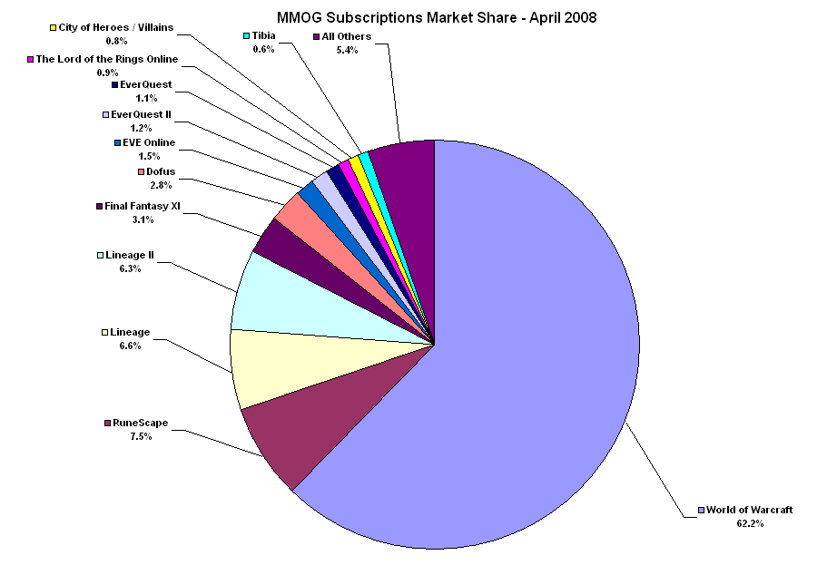
Source: http://www.mmogchart.com/charts/

Slide 113
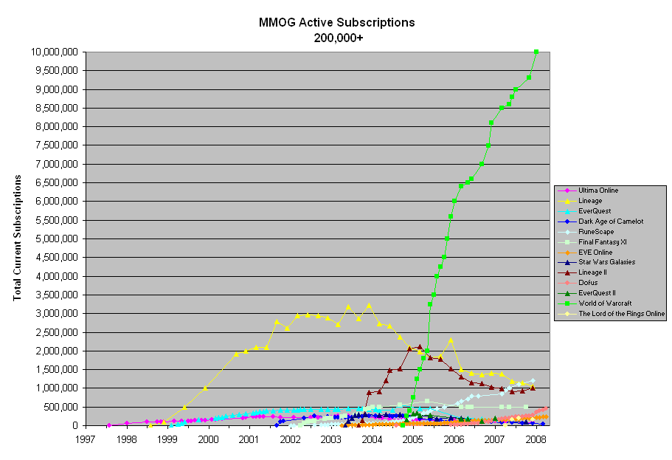
Source: http://www.mmogchart.com/charts/

Slide 114
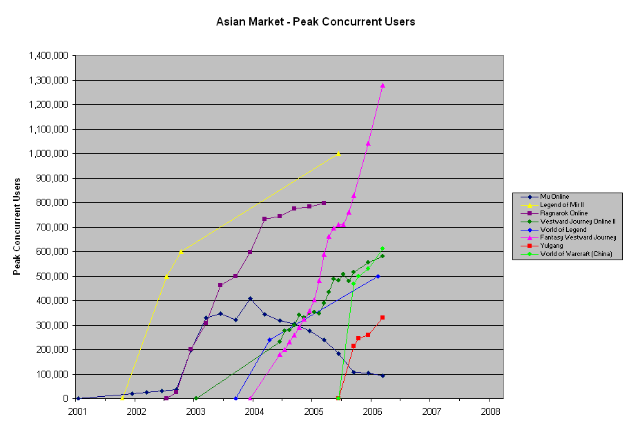
Source: http://www.mmogchart.com/charts/

Slide 115
Infrastructure
Differentiate between in-game networking and backend infrastructure
Backend infrastructure:
lobby where gamers meet
authentication and CD key checking
accounting and billing
ranking and ladder
reputation and black list
buddy lists, clans, and tournaments
mods and patches management
virtual economy
beware of DDoS
Issues: scalability, adapting to failure, security

Slide 116
DS issues
Networking topology: client-server vs. peer-to-peer
Computing model: distributed object vs. message passing
Protocol to use? tcp, udp, reliable udp
Bandwidth limitation
Latency limitation
Consistency
Cheat proofing

Slide 117
P2P architecture
Peer-to-peer with O(N²) unicast connections:
each player is connected directly to all other players
each player simulates the whole world
advantages: reduced latency, no single point of failure
disadvantages: easier to cheat, not scalable: each client must send and receive N-1 messages
used in Outback Online

Slide 118
Client-server
Two flavors:
ad-hoc servers: death match
dedicated servers: MMOG
Two types of clients:
clients simulate world, server has authoritative state: allows for client-side dead reckoning (QuakeIII/Half- Life)
clients for I/O, all simulations at server: useful for thin clients, e.g., cell phones, and persistent-world MMOG
Advantages:
each client sends only to server, server can aggregate moves
With dedicated servers: cheat- proofing, server can be better provisioned, persistent states (for MMOG)
Disadvantages: longer delay, server bottleneck, single point of failure, needs server management

Slide 119
MMOG Server Architectures
The world replicated at each server (shard)
Most MMORPGs
each shard contains an independent world
players go to specific shard Most MMORPG
The world replicated at each server (mirror)
all the worlds are synchronized
players see everyone across all mirrors
Mirrors must be kept consistent
The world is split up into regions
each region is hosted by a different server
Example: Second Life
Servers must be kept consistent

Slide 120
Which network protocol to use?
Game requirements:
late packets may not be useful anymore
lost information can sometimes be interpolated
but loss statistics may be useful
Use UDP in games:
can prioritize data
can perform reliability if needed
can filter out redundant data
use soft-state
send absolute values, not deltas
or if deltas are used, send ``baseline'' data periodically
must do congestion control if sending large amount of data

Slide 121
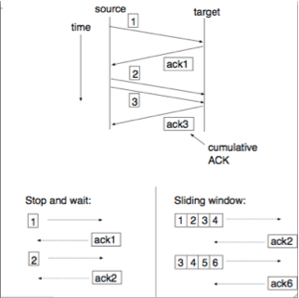
Reliable UDP
UDP doesn't provide reliability, write your own reliable UDP for moves that must be reliable, e.g., snipper shots
Desirable features:
error control: do checksum
ordering: use sequence #
reliability: acknowledge packet (use cumulative ACK), retransmit if not ACKed, timeout value a function of average rtt (round-trip time)
flow control: don't send more than the target can handle; use stop- and-wait or sliding-window

Slide 122
Bandwidth limitation
What information is sent?
game state: coordinates, status, action, facing, damage
user keystrokes
commands/moves
For AoE: 1 every 1.5-2 sec, up to 3-4 commands/sec during battles (but some of these are redundant and can be filtered out)
Bandwidth requirement has been HIGHLY optimized
Even with audio chat, takes up at most 8 Kbps
So, bandwidth is not a big issue (but note the asymmetric nature: at 8 Kbps, you can only support a total of 4 players on a 28.8 Kbps modem)
Must be continually vigilant against bloat
HOWEVER, with player-created objects and worlds, bandwidth becomes an issue again: use streaming, levels of details, and pre-fetching

Slide 123
Latency limitation
Latency:
RTS: <= 250 ms not noticable, 250-500 ms playable, > 500 ms noticable
FPS: <= 150 ms preferred
Car racing: < 100 ms preferred, 100-200 ms sluggish, >= 500 ms, car out of control
Players' expectation can adapt to latency
It is better to be slow but smooth than to be jittery

Slide 124
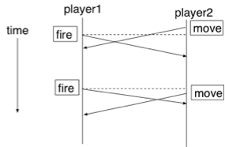
Synchronization
Synchronization: order moves by their times of occurrence
Assume globally synchronized clocks
Out-of-synch worlds are inconsistent
How long do you have to wait for the other players' moves before rendering your world?

Slide 125
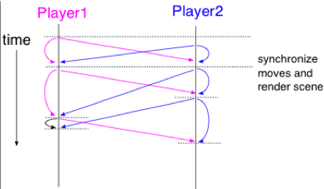
Lock-step protocol
Algorithm: Each player receives all other players’ moves before rendering next frame
Problems:
long Internet latency
variable latencies
game speed determined by the slowest player

Slide 126
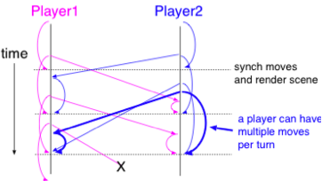
Bucket synchronization
Algorithm:
buffer both local and remote moves
play them in the future
each bucket is a turn, say for about 200 ms
bucket size can be adapted to measured rtt
Problems:
game speed (bucket size) determined by slowest player
what if a move is lost or late?

Slide 127
Pessimistic consistency
Every player must see the EXACT same world (e.g. AoE/AoK/AoM):
each player simulates its own copy of the world
all the worlds must be in sync.
uses bucket synchronization
each player sends moves to all other players
dropped packets retransmitted
a designated host collect measured rtts from all players and set future bucket sizes
Problems:
variable latencies
speed determined by the slowest player

Slide 128
Dead reckoning
Dead reckoning, a.k.a. client-side prediction
extrapolate next move based on prior moves
compute the velocity and acceleration of objects to dead reckon
players can help by sending this info along
obviously, only works if velocity and acceleration haven't changed
In case of inconsistency:
server always have authoritative view
when clients correct inconsistent views, rollback occurs and players may experience ``warping''
can players' decisions be dead reckoned? (see http://spectrum.ieee.org/sep06/4424)

Slide 129
Optimistic consistency with rollback
Observation: dead reckoning doesn't have to be limited to lost packets!
Half-Life:
each client plays back its own moves immediately and send the moves to server
each client also dead reckons the other players’ moves
server computes world and sends its authoritative version to all clients
clients reconcile dead reckoned world with server's version
can result in some jerkiness and perception of “shooting around corner”
only need to synchronize important events, but must be careful that dead reckoning error doesn't get compounded over time

Slide 131
Smoothness
For smoother playback, decouple bucket size from frame rate (even AoE does this)
Immediately render local moves
Modify game design to allow for latency and loss, e.g.,
make players wait for elevator
teleportation takes time
require multiple hits per kill
let bullet/missile have flying time
build in inertia, don't allow sudden change in facing

Slide 132
Reducing consistency checks
Do area-of-interest management (a.k.a. relevance filtering):
aura: how far you can be sensed (cloaked ships have ε aura)
nimbus: how far you can sense (use quantum-sensor to detect cloaked ships)
Aura and nimbus are defined for a given set of ``technology'’ (e.g., cloaking device, quantum sensor, etc.)
Perform consistency check only when B is within A's nimbus and A is within B's aura

Slide 133
Cheating
AoE doesn't need cheat-proofing because each player simulates each move in lock step: all moves are simulated, not just collisions
Half-Life synchronizes only collisions, higher probability for cheating
Cheats (more at megagames.com):
superhuman cheat: auto-aim, auto-position
game-state editing: boost player's profile
rule bending: see/walk through walls
sixth-sense cheat
lookahead cheat: claim to be behind slow link
suppress-correct cheat: exploit dead-reckoning, claim moves were lost, then ``reconstruct'’ advantageous moves based on others' moves

Slide 134
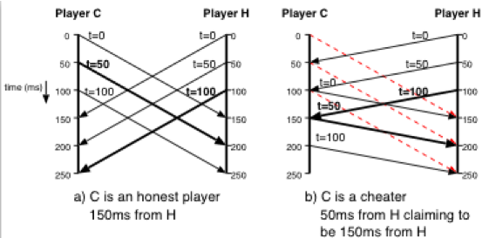
Lookahead cheat

Slide 135
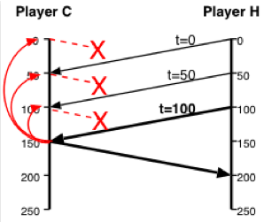
Suppress correct cheat
At time 150, C sends out a move consistent with fake moves at time 0, 50, 100 that were actually computed upon receiving packets from H

Slide 136
Cheating solutions
Lockstep Protocol : No host receives the state of another host before the game rules permit
Player decides but does not announce its turn t + 1
Each player announces a Cryptographically secure one-way hash of its decision as a commitment.
After all players have announced their commitments, players reveal their decisions.
Each host can verify revealed decisions by comparing hashes.

Slide 137
Cheating solutions
Asynchronous Synchronization : Relaxes the requirements of lockstep synchronization by decentralizing the game clock
Player determines its decision for the turn and announces the commitment of the decision to all players.
Commitments that are one frame past the last revealed frame of a remote player are accepted.
Before revealing its commitment, the local player must determine which remote players it is waiting for.

Slide 138
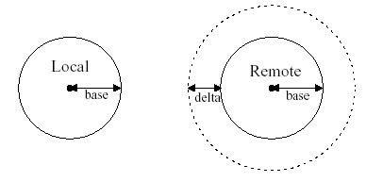
Cheating solutions
Asynchronous Synchronization Continued :
A remote player is not in the wait state only if there is no intersection with the SOI dilated from the last revealed frame of the remote player.
The SOI is calculated using the base radius of the last known position plus a delta radius.

Slide 139
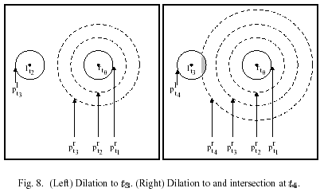
Cheating solutions
Asynchronous Synchronization Continued :
Finally, if no remote hosts are in the wait state, the local host reveals its state turn for turn t, updates its local entity model of each other player with their last known state, including the remote hosts last known time frame and advances to the next turn.

